Slide 1
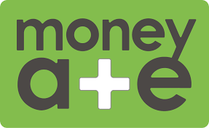
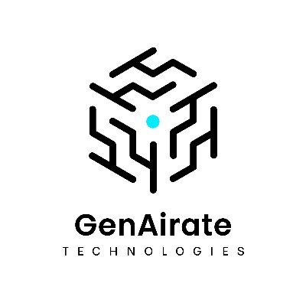
Money A&E enables 94% increase in multilingual advisory services using GenAirate's AI solution
Money A&E, a provider of money advise & education services, struggled to effectively communicate with their diverse clientele who speak languages such as Bengali, Spanish and English. Language barriers led to misunderstandings, extended meeting times and limited the firm's ability to serve non-English speaking communities.
GenAirate's multilingual solution has been transformative. Our advisors can now focus on financial guidance while AI handles the language barriers. Client satisfaction has increased dramatically and we're reaching communities we couldn't serve effectively before.
GenAirate Technologies developed a real-time bidirectional multilingual communication platform which was built on Amazon Bedrock and leverages several services (EC2, S3, SES, SNS, DynamoDB and Lambda). The custom virtual meeting rooms support all four languages with enterprise-grade security, eliminating the need for human translators or extended meetings.
Gregory Ashby (MBE) – Co Founder at Money A+E CIC
Money A&E now automate language translation needs, reducing the cost of external translation services. Client satisfaction scores have increased, while meeting duration decreased, allowing advisors to serve more clients. Additionally, Money A&E predict a 25% growth in their non-English speaking client base.’

